Slide 1

Advancements in EEG Denoising and Artifact Removal using Transformers
Internship Report
Bachelor in Applied Computer Science and Artificial Intelligence
Martina Doku 1938629
Academic Year 2022/23
Notes:
Good morning/afternoon/evening everyone,
Today, I'm delighted to have the opportunity to present my internship report, which focuses on an incredibly fascinating field of study: Electroencephalography, or EEG for short specifically I worked on the denoised of the aforementioned waves.

Slide 2


Table Of Contents
Context
Objectives
Approaches
Proposed Solution
Results
Conclusions
Notes:
Through my presentation, I aim to provide you with a comprehensive overview of the project, highlighting its context, objectives, previous approaches, the methodology employed, and finally, the conclusions drawn from my research.

Slide 3
Context ●
EEG
EEG stands for Electroencephalography
It is a non-invasive technique used to record the electrical activity of the brain
It measures voltage fluctuations resulting from ionic current flows within the neurons of the brain
It is widely used in neuroscience for diagnosing and monitoring brain disorders and brain injuries
Notes:
Before delving into the specifics of my internship experience, I'd like to take a moment to provide you with an overview of what EEG entails and why it's such a crucial area of research. EEG is a non-invasive technique that measures the electrical activity of the brain using electrodes placed on the scalp. By capturing these brainwave patterns, EEG enables us to gain insights into the functioning of the human brain, understand cognitive processes, and investigate various neurological conditions.
This technology is therefore used not only for a huge variety of medical investigations but is also gaining more space in commercial applications.

Slide 4
Table Of Contents
Context
Objectives
Approaches
Proposed Solution
Results
Conclusions
Notes:
Moving on to the core topic of the internship, I’d like to give an insight of what are the Objective of this study.

Slide 5
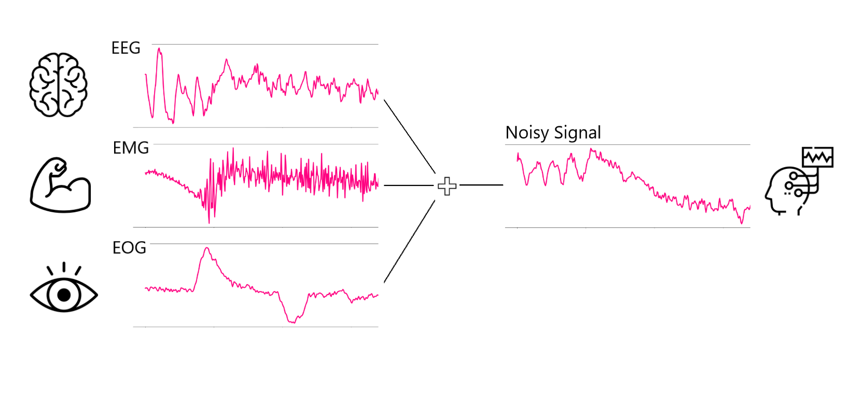
Objectives ●○
Noise
Notes:
Moving on to the core topic of the internship, I’d like to give an insight of what noise in the EEG field. When performing and electroencephalraphy, we are not only recording the signal coming from our neural activity, but also signals coming from muscles, especially eyes, that are placed closely to the electrodes. The signal recorded from the sensors is then a mixture of all of these different signals coming from different parts of our bodies.

Slide 6
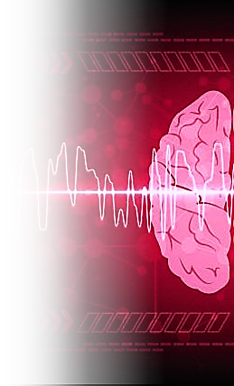
Objectives ○●
Objective
The objective of this project is to develop a new method to retrieve the original signal free from noise and artifacts.
The main goal is to outperform previous architectures on quality of EEG denoising.
Notes:
The main scope of this project was to devise an innovative approach that surpasses existing methods in extracting the true essence of brain signals and unveiling the underlying neural activity eliminating distortions.
Our approach capitalizes on cutting-edge techniques, empowering us to push the boundaries of what has been done up to these days.
We aim not only to meet expectations but to exceed them, unlocking new possibilities for accurate and reliable EEG analysis.

Slide 7
Table Of Contents
Context
Objectives
Approaches
Proposed Solution
Results
Conclusions

Slide 8
Approaches ●○
Approaches
Fourier Transforms
Wavelet Transforms
Filtering
Regression
Blind Source Separation
FCNN
CNN
RNN
Encoder
Transformer
Mathematical Methods
Artificial Intelligence
Notes:
Taking a step back onto previous approaches, we can see that some work has been done. Starting from the elederly stages of EEG denoising we have some common signal analyss methods, such as furier transforms and wavelet transforms. Then we have some signal analysis methods specifically suited for EEG such as regression filtering and blind source separation. In the latest years a compltely different approach has been proposed, the artificial intelligence has taken a step further in that task producing promising results. Here are some architectures that hav e been used, such as fully connected neural networks, Convolutional neural networks, recurrent neural networks encoder and, lastly transformers, whse result i’ve had the challenge to measure myself with.

Slide 9
Approaches ○●
Problems
not able to remove all kind of artifacts
  not fitting for real cases scenarios
require external data to be applied
  infeasible for real time application and incompatible with the low amount of EEG data
perform well only on some kind of noise
  not fitting for real cases scenarios
all the methods still have a high range of growth in performance

Slide 10
Table Of Contents
Context
Objectives
Approaches
Proposed Solution
Results
Conclusions

Slide 11
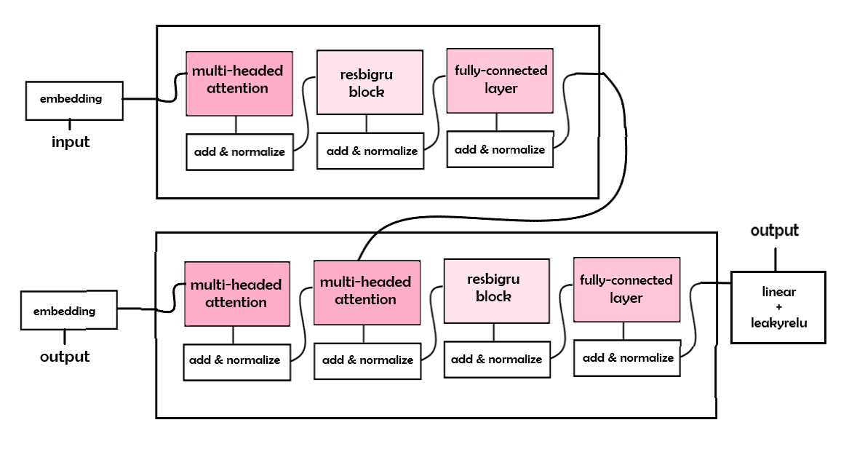
Proposed Solution ●○○
Architecture

Slide 12
Proposed Solution ○●○
Key Feature: Attention
Attention is a crucial component in modern deep learning models.
It allows the model to focus on relevant information while selectively ignoring irrelevant parts.
By dynamically weighting the importance of different input elements, attention enables enhanced performance and interpretability.

Slide 13
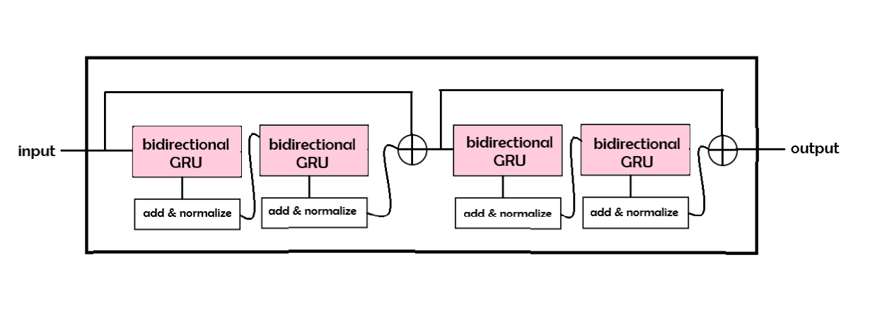
Proposed Solution ○○●
Key Feature: Residual Bidirectional GRU

Slide 14
Table Of Contents
Context
Objectives
Approaches
Proposed Solution
Results
Conclusions

Slide 15

Results ●○○
Data
BEFORE PROCESSING:
4514 clean EEG signals
3400 clean EOG signals
5598 clean EMG signals
AFTER PROCESSING:
34000 EOG contaminated signals
55980 EMG contaminated signals
Notes:
The clean EEG signals and noise signals are augmented adding random disturb
The EEG signals are partially reused to match the EMG and EOG signals
Data are divided in training, validation, and test sets
The noise signals are added to the EEG signals
The noisy EEG signals are normalized by dividing them by the standard deviation

Slide 16
Results ○●○
Comparison

Slide 17
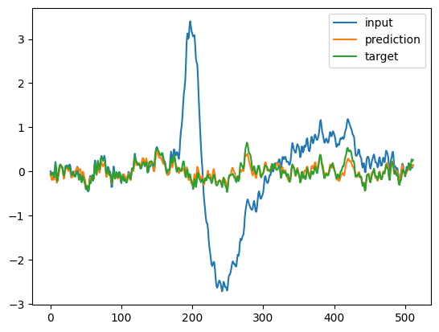
Results ○○●
Results

Slide 18
Table Of Contents
Context
Objectives
Approaches
Proposed Solution
Results
Conclusions

Slide 19
Conclusions ●
Conclusions
The advancements obtained with the proposed model will allow to improve the performance of EEG based BCI systems, making them more robust and reliable.
Future research could further explore more complex architectures and parameter tuning and other innovations to achieve even more remarkable results.

Slide 20
Advancements in EEG Denoising and Artifact Removal using Transformers
Thank you for listening!
Any questions?

